Slide 1

CampusTrail: Your Campus-Only Travel Hub
Value Proposition: CampusTrail is a campus-only platform where students can rent travel gear, share itineraries, and find companions—with deposits, reviews, and dispute resolution for trust.
Observed Pain: Student trip planning is fragmented across separate tools; coordination fails at handoff/payment steps.
Tool Fragmentation:
Gear: Bragpacker / SharePal
Companions: Meetup / GAFFL
Itineraries: Itinsy / Stippl / Google Docs
No Campus Context: Existing tools are not campus-verified, lack deposit/escrow logic, and don’t align with hostel pickup points and club operations.
Google Scan Insight: No integrated, campus-specific solution → students DIY patchwork → time loss, higher risk, drop-offs.
Opportunity: Bundle the full journey with a trust layer and UPI-ready flow, tuned for short-haul campus handoffs.

Slide 2
Problem Validation & Insights (Why Now)
Identity Silos
No Escrow in Planning Apps
Off-platform IDs → weak accountability and safety concerns in peer exchanges.
Itinerary/companion tools rarely support deposits or structured disputes.
Operational Friction
Fragmented Reviews
Pickup/return steps are unclear → no-shows, late returns, and asset damage.
Feedback scattered across apps; no single reputation that travels with the student or item.
Campus Specificity Missing
India Context Trigger
.edu verification; society tie-ins; locker hubs; common pickup windows; club governance needs.
UPI ubiquity + QR literacy + smartphone usage → low-friction deposit holds and confirmations.
Conclusion: There’s a practical, immediate gap where a verified campus network + deposits materially improves outcomes.

Slide 3
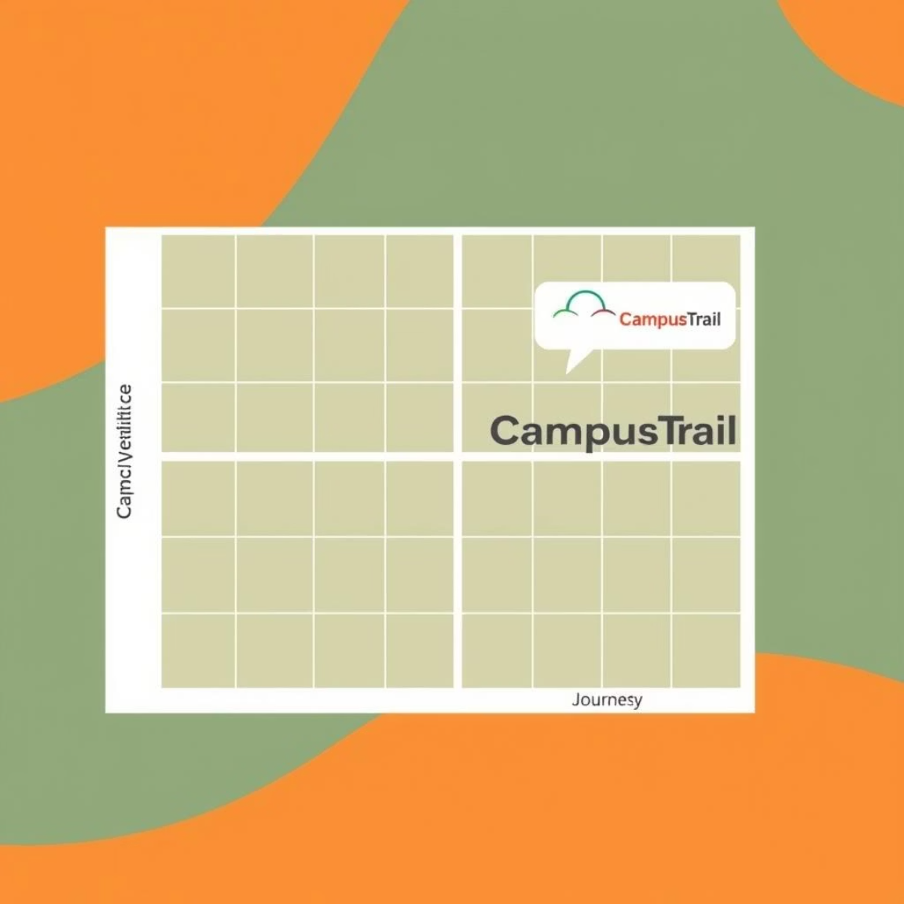
Competitive Landscape (Category Map & Takeaways)
People-centric: Meetup, GAFFL → great for open communities, but not campus-verified, no gear or deposit flows.
Plan-centric: Itinsy, Stippl, Docs → strong for itinerary sharing, but no transactional handoff to gear or companions.
Gear-centric: Bragpacker, SharePal → robust city-wide rentals, but not integrated with itineraries/companions; not campus-verified.
Where they fall short:
Campus trust (verification, reputation continuity)
End-to-end journey (gear ↔ itinerary ↔ companions)
Risk controls (hold→capture/release, disputes)
Local handoffs (hostel/locker SLAs)
CampusTrail Positioning: Top-right of a 2×2 (Campus Verification ↑ vs Journey Coverage ↑) → verified, all-in-one, escrow-enabled.

Slide 4




What Exists vs What’s Missing (and our Answer)
Gear rental
(Bragpacker/SharePal) → Off-platform identity; campus trust missing → Verified profiles + deposit lifecycle + reviews.
Itinerary sharing
(Itinsy/Stippl/Docs) → No tie-in to real campus gear → Itineraries linked to gear + companion matching.
Companions
(Meetup/GAFFL) → Broad audience; fit/safety uncertain → Campus-only network + interests/style filters.
Payments & Risk
(stand-alone payments) → No deposit logic; weak recourse → Hold→capture/release + dispute outcomes + audit logs.
Net Effect: CampusTrail reduces search cost, raises safety & accountability, and keeps the transaction on-platform.

Slide 5






Solution Overview (All-in-One)
Gear Rentals
Itinerary Sharing
Buffer-aware availability (DAY/PARTIAL), deposit holds, QR/OTP pickup/return, inspection and outcomes.
Interests/style, capacity with approvals, match score to companion requests; shared gear cart linkage.
Companion Matching
Trust Layer
Verified campus profiles, safety cues, host approvals; planned messaging for coordination.
Polymorphic reviews (gear/itinerary/user/companion), disputes with evidence & policy matrix, audit trail.
Security & Auth
Payments Readiness
OTP→JWT; rate limits; minimal PII; optional event logs.
UPI-ready flow; gateway integration next for real deposit holds and receipts.
Why It Works: Integrates journeys + trust + local ops, aligned to campus constraints.

Slide 6
Why “Campus-Only” Wins (Moats & Economics)
Trust Moat
Liquidity Density
.edu verification + repeat interactions inside a known community reduce moral hazard.
Campus concentrically boosts time-to-match and on-time pickups, increasing conversion.
Operational Advantage
Convenience Stack
Short-haul handoffs, locker pilots, and common pickup windows → lower logistics friction.
Single profile/wallet/deposit/chat → fewer drop-offs and better user experience.
Reputation Flywheel
Unit Economics
Connected reviews across people + items + plans → more reliable counterparties over time.
Dense nodes → more GMV/user, lower CAC via referrals/ambassadors; deposit logic → lower loss rates.

Slide 7
Product Modules: Now / Next / Later
Now (MVP live):
Next (V1.1–1.2):
Later:
Gear marketplace; itineraries; companions; orders (snapshot); polymorphic reviews; disputes scaffold; OTP→JWT; optional MSSQL logging.
Dispute management UI (timeline, evidence, decisions); Orders in profile; review filters/caching; file uploads; Postgres migration; standardized errors & pagination; PWA polish.
Payment gateway (UPI/cards) for real holds; messaging/notifications; recommendations; reputation score; locker hubs; club/admin dashboards; insurance add-ons.
Design Principles: TS-first; input validation with Zod; auditability; mobile-first flows; runbooks for handoffs & disputes.

Slide 8







Architecture (High-Level; Built for Evolution)
Frontend
Backend
React 18 + Vite; TypeScript; Tailwind; Framer Motion; PWA path.
Node.js + Express (TS); Zod for request validation; idempotent patterns planned for payments.
Data Layer
Auth & Security
Prisma ORM; SQLite (dev) → Postgres (prod); MSSQL logging (optional) with timeout-safe disable.
Email OTP→JWT; rate limits; minimal PII; audit logs; principle of least privilege.
Observability
Integration Surfaces
Health endpoints; analytics events; Sentry/PostHog planned; error envelope normalization.
Payment gateway hooks (hold/capture/release); S3/Blob for media; notification bus (later).
Why this stack: Typed, simple, battle-tested, with a clean migration path and strong developer velocity.

Slide 9
Core User Journey — Generic Rental (Vertical Diagram)
1
Browse → Select → Request
2
Approve
3
Deposit Hold (UPI)
4
QR/OTP Pickup
5
Use → Return
6
Inspection
7
Release/Capture
8
Reviews
Buffer Logic: DAY/PARTIAL modes add guard bands to avoid overlaps and protect item turnaround.
Controls: Deposit as a pre-pickup gate; QR/OTP creates a chain-of-custody; inspection drives financial outcome.
Outcomes: Faster, safer rentals; lower dispute rates; reputation accrues to both sides.

Slide 10


Use Cases (Tangible Wins)
Fest DSLR Rental:
Last-Minute Tripod:
Time-sensitive approvals; high deposit; QR pickup at media room; return inspection; mutual reviews; partial capture if needed.
Proximity + slot filter; instant approval; ≤30-min pickup; auto-release on OK return; micro-review nudges.
Trekking Group Formation:
Impact: Validates both high-value (risk-managed) and low-value (habit-forming) rentals; increases repeat usage.
Host itinerary; match candidates; shared gear cart; per-item rentals to multiple lenders; synchronized pickup/returns; multi-entity reviews.

Slide 11

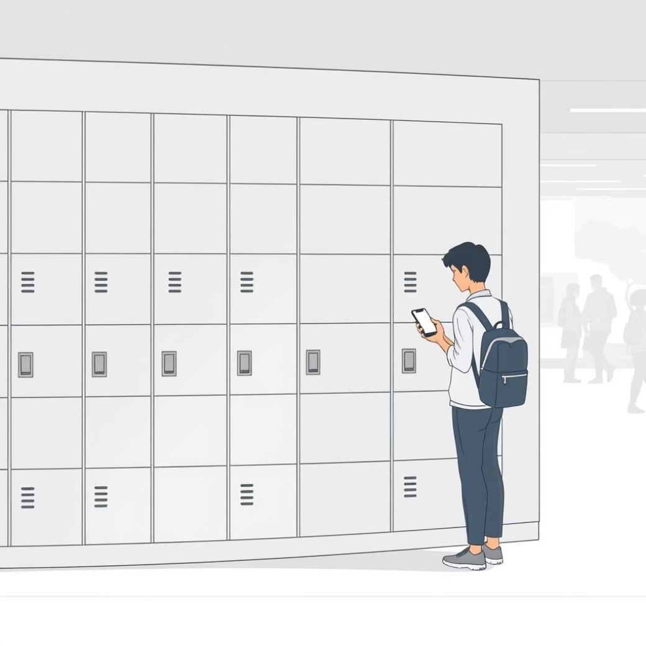

Clubs & Campus Admin (Inventory + Governance)
Club Gear Pool
Locker Pilot
Campus Admin View (Future)
Dedicated profiles for student clubs allow for bulk listings of gear, managing an approvals queue, and streamlined QR/OTP handoffs. Clubs can access utilization dashboards and monthly ledger exports for transparent governance.
Facilitates quick and secure gear exchanges through hostel or common-area lockers. Features include access control and audit logs, significantly reducing the overhead of coordinating manual pickups and returns.
Future enhancements include a dedicated view for campus administrators, offering visibility into escalations, ensuring policy compliance, and providing safety reporting. This also enables co-branded programs for enhanced campus engagement.
These features combine to deliver lower gear loss, higher utilization rates, and transparent governance, saving significant staff time for clubs and campus administration.

Slide 12





Trust & Safety: Building a Secure Community
Deposit Lifecycle
Dispute Resolution Flow
Utilizes UPI-based deposit holds at QR/OTP pickup. Deposits are automatically released upon successful return and item inspection. In cases of damage or late return, a partial or full capture is initiated with auditable receipts and transparent policy application.
A dedicated Dispute Management UI allows users to upload photo/video evidence and chat logs. Campus moderators review cases against a pre-defined policy matrix, with all decisions and communications logged in an auditable timeline for transparency and fairness.
Reputation System
Policy Center
A polymorphic review system collects feedback on users, items, and shared itineraries. These contributions, combined with .edu verification and interaction history, build a dynamic reputation score that fosters trust and informs future campus interactions.
Provides clear, accessible guidelines for scenarios like late/no-show penalties, cancellation windows, and item condition benchmarks. This reduces ambiguity, minimizes moral hazard, and empowers users and campus admins with standardized operating procedures.
This robust framework ensures fairness, accountability, and user confidence for every interaction on campus.

Slide 13

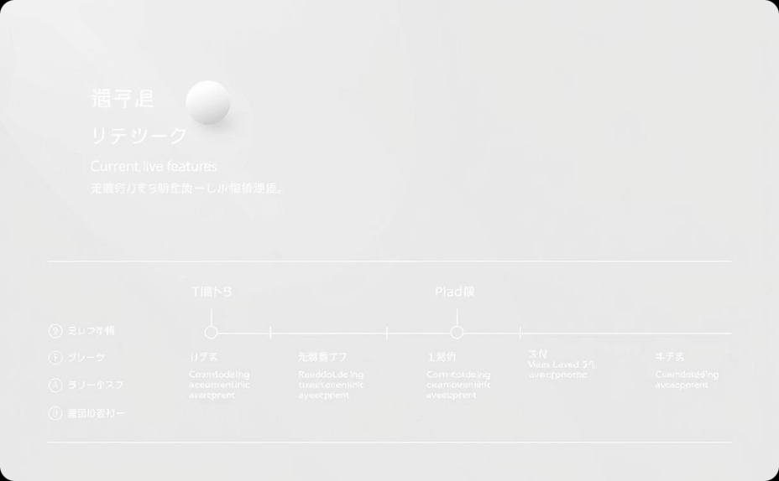
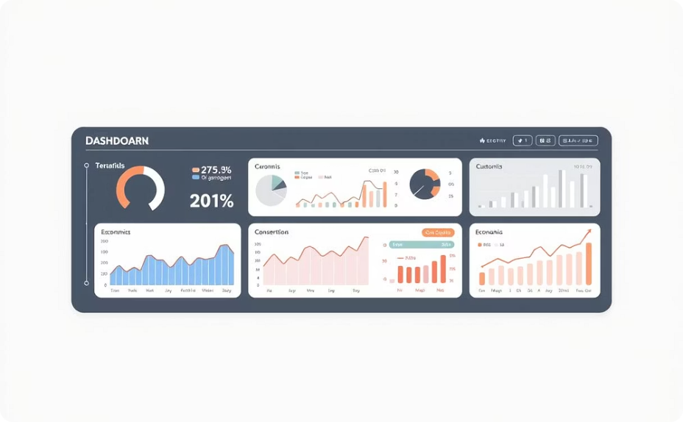
Business Model, Early Proof & Economics
Business Model (Draft)
Early Proof & Next Steps
Key Metrics & Growth
Our model centers on an 8–12% take-rate on rental fees. Future revenue streams will include featured listings, club partnerships, locker access, insurance add-ons, and admin dashboards.
The MVP is live with a gear marketplace, itineraries, companions, reviews, and secure authentication. Our next build focuses on dispute management UI, comprehensive orders, advanced review features, and payment integration.
Our North Star Metric is completed rentals per month. We monitor GMV, take-rate, CAC, and repeat user engagement, driven by key inputs like listings, conversion rates, and dispute rates.
This model thrives on campus density and trust to significantly boost conversion and retention. Secure deposits manage risk effectively, while robust referral programs reduce CAC.

Slide 14

Go-to-Market Strategy
Seeding Supply
Recruit 10–15 campus ambassadors to champion the platform.
1
Formalize Memorandums of Understanding (MoUs) with key student clubs.
Introduce "featured lister" badges for highly active contributors.
Offer fee holidays to incentivize early inventory listings.
Channels
Conduct in-class demos and workshops.
Set up interactive pop-ups at campus festivals and events.
2
Run targeted campaigns on Instagram and WhatsApp.
Implement referral credits to encourage peer-to-peer growth.
Create UTM-tracked content for organic reach.
Partner with society newsletters for wider promotion.
3
Messaging
"One app for gear, plans, and people—campus-verified and deposit-protected."

Slide 15
Tactics & Measurement
Adoption UX
Mobile-first PWA: Seamless, app-like experience without app store downloads.
1
UPI Checkout: Fast, secure, and familiar payment processing.
QR at Pickup: Efficient, secure, and auditable item handoffs.
Concise Policy Tooltips: Clear, on-demand explanations of rules and guidelines.
Friction Logging: Continuous identification and resolution of user pain points.
Measurement
Funnel Conversion: Tracking from Views → Requests → Approvals → Deposit Holds → Pickups → Returns.
2
Time-to-First-Match: Efficiency of connecting users with desired items.
Repeat Renter %: Indicator of user satisfaction and platform stickiness.
NPS (Net Promoter Score): Gauging overall user loyalty and advocacy.
K-factor: Measuring viral growth and organic referrals.
These tactics are designed to drive efficient user onboarding and sustained engagement, while comprehensive metrics ensure we can track performance and iterate effectively.

Slide 16

Risks & Mitigations
Key Risks
Mitigations
Cold Start: Low early supply/demand density on campus.
Market Seeding: Campus ambassadors, club tie-ups, fee holidays; seed 60+ listings pre-launch.
Trust & Safety: Potential for fraud, item damage, or no-shows.
Robust Safeguards: Deposits, QR/OTP chain-of-custody, evidence-based disputes, repeat-based perks.
Operations: SLA breaches, payment gateway downtime, evidence gaps in disputes.
Regulatory: Navigating GST on fees, grievance redressal, and user privacy.
Operational Resilience: Incident runbooks, 6h/24h SLAs, timeout-safe logging, retries & fallbacks.
Compliance Focus: Clear Terms of Service, policy center, campus MoUs, data-minimal design.

Slide 17

Product Roadmap & Key Milestones
T-12 to T-9: Foundation & Design
T-5 to T-3: Alpha Release
T0: Official Launch
T+4 to T+6: Enhanced Features
Public launch, stabilizing operations and user experience.
Discovery, prototyping, and policy drafting.
Alpha testing, buffer logic, dispute system scaffolding.
In-app messaging, recommendations, reputation v1, admin dashboards.
1
2
3
4
5
6
7
8
T-8 to T-6: MVP Core Build
T-2: Beta Hardening
T+2 to T+3: Payments Live
T+7 to T+9: Scaling Infrastructure
Refining match scoring algorithms and policy center.
MVP development: core rental and user interaction flows.
Payment gateway integration (deposit holds, captures, releases).
Smart locker pilot, Postgres migration, and robust CI/CD.
Key Milestones & Targets
T+3: GMV of ₹1–1.5L/month, request-to-paid conversion ≥25%, dispute rate ≤2%.
T+12: GMV of ₹5L+/month, presence in 2 campuses, Net Promoter Score (NPS) ≥45.

